Slide 1

Formula 1 (F1) Racing
Team 1
Yashwant Singh Katailiha
Tejeshwar Reddy Palampalli

Slide 2
TABLE OF CONTENTS
Problem Statement
Business Rules
Data Collection
Implementation model
ERD
Reports
Difficulties Faced

Slide 3
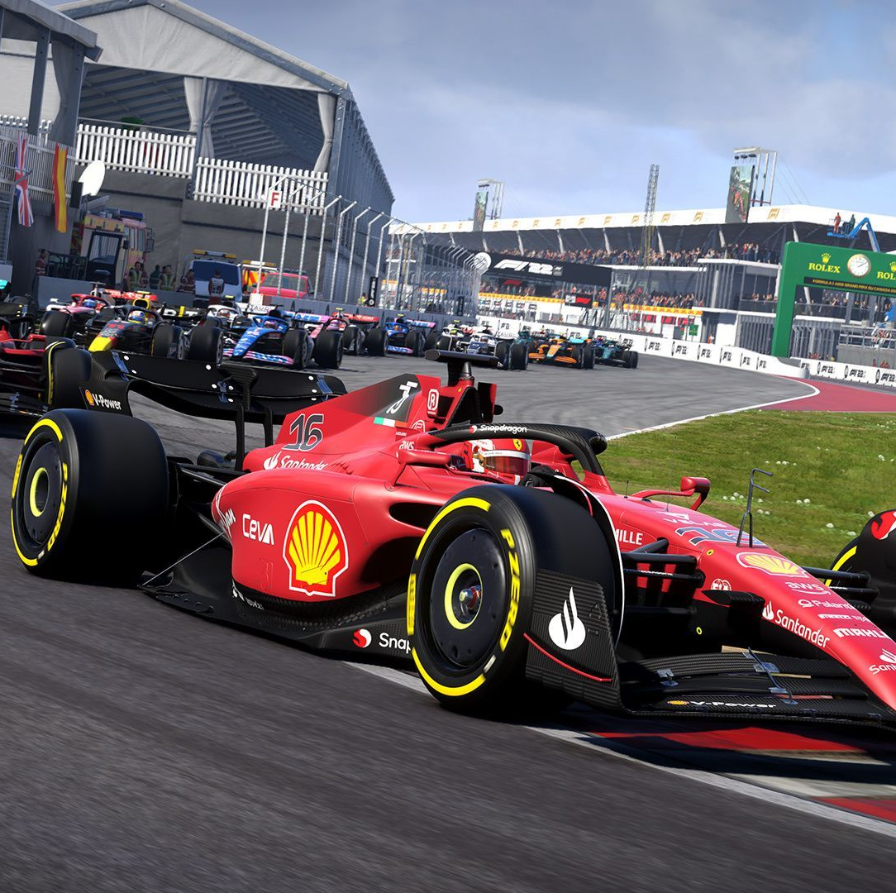
Problem Statement
Formula One (F1) racing teams face challenges in efficiently managing and utilizing data related to racers, circuits, pit stops, teams, sponsors, coaches, races, championships, and cars. Current databases may lack integration, real-time processing capabilities, and comprehensive analytics, hindering teams' ability to optimize performance, make strategic decisions, and attract sponsors effectively.
The goal is to develop an integrated data management and analytics system for F1 racing teams that enables real-time processing, comprehensive data integration, and advanced analytics capabilities. This system should empower teams to optimize performance, make data-driven strategic decisions, and effectively engage with sponsors, thereby enhancing their competitiveness and success in the F1 racing circuit.

Slide 4
Business Rules
Racer Entity: Each racer entity must have a unique identifier, personal details (name, address, phone number, nationality, and family details). A racer can have one or multiple coaches and should participate in one and only one championship at a time. A racer may drive one car and must drive for only one team.
Circuits Entity: Circuits must be uniquely identified and include details such as location, track layout, temperature, construction date. On a circuit, many races can happen and many teams can race at a circuit.
Pit Stop Entity: Pit stops must be tracked during races, including details such as timing, tire changes, fueling, and any mechanical adjustments made to the car and racer change time. A team must have a pitstop.
Team Entity: Teams must have a unique identifier, team name, owner name, team principal/coach, drivers, technical staff, and a list of sponsors. A team can race on many circuits. A team can have one or many coaches and racers. A team can participate in many championships. A team must have one car but can also build many cars. A team can have multiple sponsors. A team must have one pit stop while racing.

Slide 5
Sponsor Entity: Sponsors must be tracked, including details such as sponsor name, contract duration, financial terms, and basic terms. A sponsor must give sponsorship to one and only one team at a time.
Coach Entity: Coaches must be associated with a team and have details such as name, expertise, and contact information. A coach can give coaching to multiple racers but a coach must be present in one and only one team.
Race Entity: Races must be uniquely identified and include details such as date, location, circuit, weather conditions, winner name, and lap-by-lap analysis. Only one race can happen at a circuit.
Championship Entity: Championships must be tracked, including details such as season, winner name, runner name. Two or more racers and two or more teams can participate in one championship.
Car Entity: Cars must be associated with a team, including details such as chassis number, engine type, wheel specifications, body modifications, and performance data. Many racers can drive one car. A car belongs to one and only one team. A car can be divided into engine, wheel and body subtypes according to their performance. Each car subtype must have specific attributes and performance characteristics, allowing teams to analyze and optimize car setups for different race conditions.

Slide 6
DATA COLLECTION
The data has been gathered in compliance with the business regulations. We've ensured that all essential information for each attribute is collected and maintained the consistency of foreign keys and primary keys.
This task involves collecting information about different racers, including cars, their coaches, sponsors and circuits, real-time time required for tires and fueling . This data can be sourced from racing schedules, descriptive reports, and real-time racing tracking systems.
Acquiring information regarding racing logistics, like car ID, specifications, weight, and corresponding race events, plays a pivotal role in overseeing racing operations, including preparation, competition, and maintenance.
Data has been entered manually into a SQL database using SQL statements
We made sure that there are 10 entries for every attribute in every table.
We made sure that every foreign key is connected to its respective table.
The data collection must occur via diverse channels, including direct feeds from racing teams, manual input by race personnel, and integration with racing event management systems.

Slide 7
ER DIAGRAM

Slide 8
IMPLEMENTATION MODEL
Racer Entity: (Racer_ID (PK), Team_ID (FK), Car_ID (FK), Championship_ID (FK), Racer_F_Name, Racer_L_Name, Address_1, Address_2, City, State, Zip_Code, Phone_Area_Code, Phone_Number, Racer_Nationality)
Circuit Entity: (Circuit_ID (PK), Address_1, Address_2, City, State, Zip_Code, Circuit_Temperature, Circuit_Track_Layout, Circuit_Construction_Date)
Pit_Stop Entity: (PS_ID (PK), Team_ID (FK), Tire_Change_Time, PS_Fueling_Time, Racer_Change_Time, Repair_Time,Total_Time)
Team Entity: (Team_ID (PK), Team_Name, Team_Owner_F_Name, Team_Owner_L_Name, Team_No_Of_Drivers )
Sponsor Entity: (Sponsor_ID (PK), Team_Id (FK), Sponsor_F_Name, Sponsor_L_Name, Sponsor_Contract_Duration, Amount, Basic_Terms)

Slide 9
Coach Entity: (Coach_ID (PK), Team_ID (FK), Coach_F_Name, Coach_L_Name, Address_1, Address_2, City, State, Zip_Code, Phone_Area_Code, Phone_Number, Coach_Expertise)
Race Entity: (Race_ID (PK), Circuit_ID (FK), Championship_ID (FK), Race_Date, Winner_F_Name, Runner_F_Name, Temperature)
Championship Entity: (Championship_ID (PK), Season_ID, Season_Name, Winner_F_Name, Winner_L_Name, Runner_F_Name, Runner_L_Name)
Car Entity: (Car_ID (PK), Team_ID (FK), Car_Chassis_Number, Car_Engine_Type, Car_Wheel_Specifications, Car_Body_Modifications, Car_Performance_Data)
Family Entity: (Family_ID (PK), Racer_ID (PK,FK), First_Name, Last_Name, Address_1, Address_2, City, State, Zip_Code, Phone_Area_Code, Phone_Number)
Laps Entity: (Lap_Number (PK), Race_ID (PK,FK), Winning_Team, Winning_Lap_Time)

Slide 10
Technical_Staff Entity: (Staff_ID (PK), Team_ID (PK,FK), Domain, First_Name, Last_Name Engine Entity
(Car_ID (PK,FK), Engine_Part_ID, Part_Name, Count)
Wheel Entity: (Car_ID (PK,FK), Wheel_Part_ID, Part_Name, Count)
Body Entity: (Car_ID (PK,FK), Body_Part_ID, Part_Name, Count)
Racer_Coach Entity: (Racer_ID (PK,FK), Coach_ID (PK,FK))
Champ_Team Entity: (Championship_ID (PK,FK), Team_ID (PK,FK))
Circuit_Team Entity: (Circuit_ID (PK,FK), Team_ID (PK,FK))
Parts Entity: (Part_Type (PK), Classification)

Slide 11
NORMALIZATION

Slide 12
REPORT 1
How do different factors such as pit stop efficiency, coach expertise, and car specifications impact the overall performance of Formula One racing teams?
It includes details such as team names, pit stop times for tire changes and refueling, coach expertise, car engine types, and car wheel specifications.
By joining information from multiple tables (Pit_Stop, Car and Coach), the report offers insights into how different aspects such as coaching expertise and car specifications may influence team performance during races.
Helps team identify correlations between various factors (like coach expertise, car specifications, and pit stop times) and overall performance.
Enables data-driven decisions for performance optimization.

Slide 13
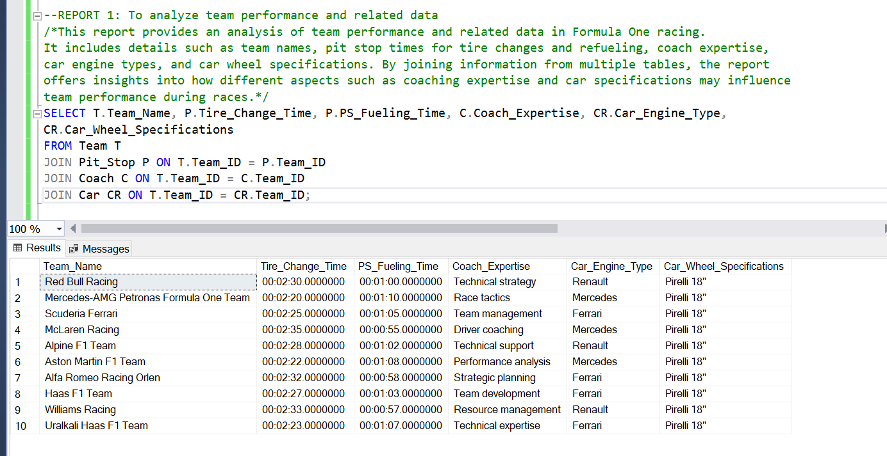
SQL QUERY AND OUTPUT

Slide 14
REPORT 2
How do sponsorship engagements correlate with team performance across different championship seasons in Formula One racing?
This report provides information about sponsorship engagement and team performance in Formula One racing. It includes details such as sponsor names, team names, championship seasons, and the winning/runner-up racers for each season. The data is presented in descending order based on championship seasons, offering insights into sponsor-team relationships and performance trends over time.
Provides visibility into sponsor-team relationships and their impact on team performance.
Facilitates the evaluation of sponsorship effectiveness and contribution to team success.

Slide 15
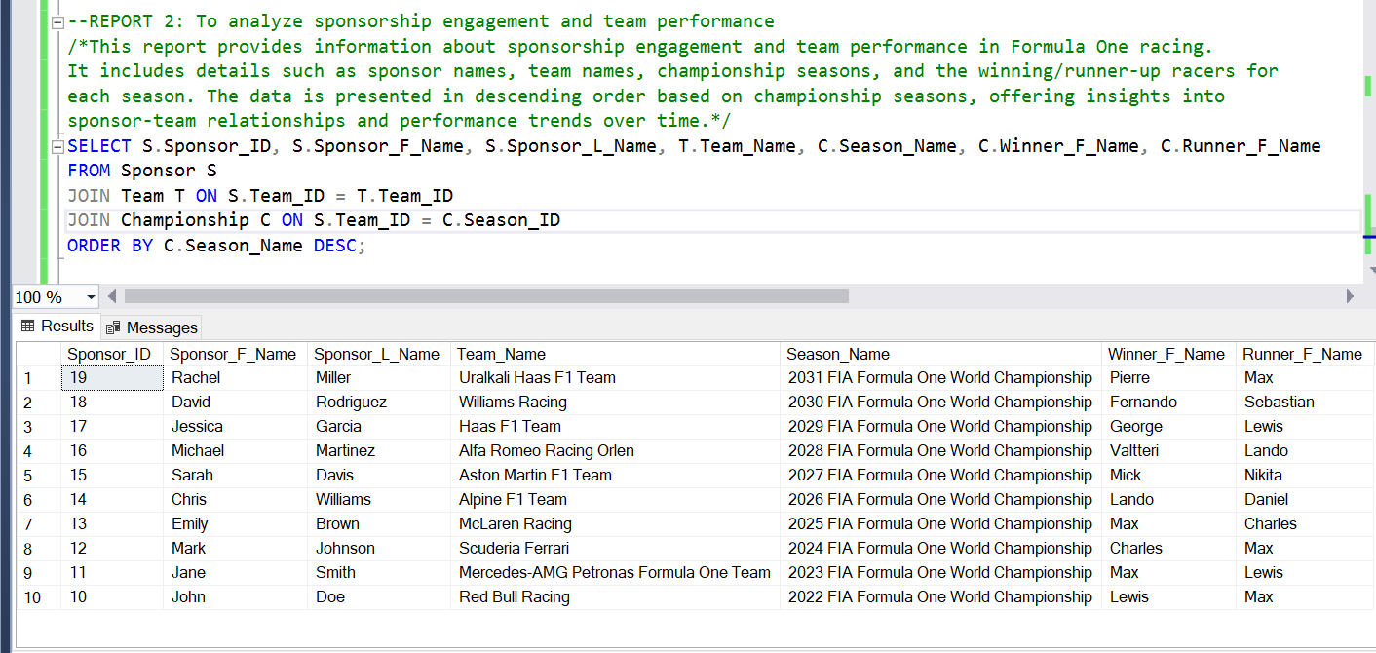
SQL QUERY AND OUTPUT

Slide 16
REPORT 3
What are the task completion times for each team during pit stops, and how does this data reflect on their efficiency in pit stop management and overall race performance?
Teams that finish these tasks quickly are usually better at managing pit stops, which can make a big difference in how well they do in races.
This report helps teams see where they can make their pit stops faster and improve how well they race overall.
Identifies areas for improvement in pit stop processes, leading to faster and more efficient pit stops during races.
Enhances overall race performance by optimizing critical operational aspects.

Slide 17
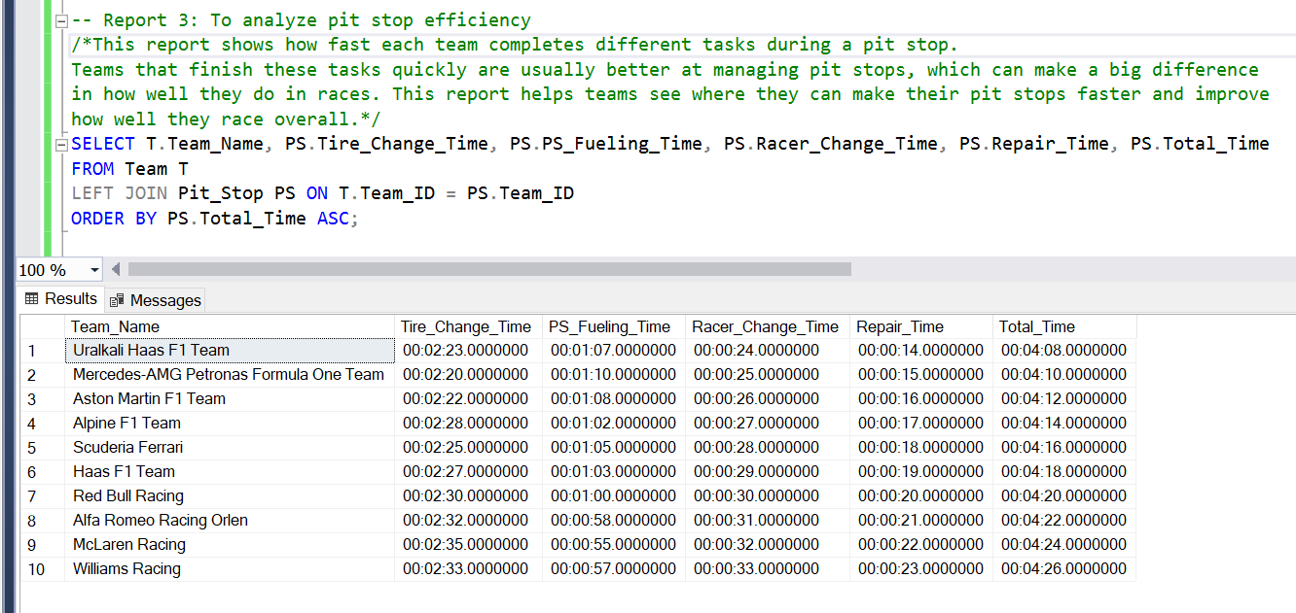
SQL QUERY AND OUTPUT

Slide 18
REPORT 4
What financial insights can be gained from the sponsorship contracts in Formula One racing, including details like team names, sponsor information, contract durations, and sponsorship amounts?
This query retrieves data related to sponsorship contracts, including the team name, sponsor details, contract duration, and sponsorship amount. It provides insights into the financial relationships between teams and sponsors, helping to evaluate the significance of sponsorships in Formula One racing.
Offers insights into the financial aspects of sponsorships, including contract duration and sponsorship amounts.
Helps teams assess the significance of sponsorships in terms of financial support and resource allocation.

Slide 19
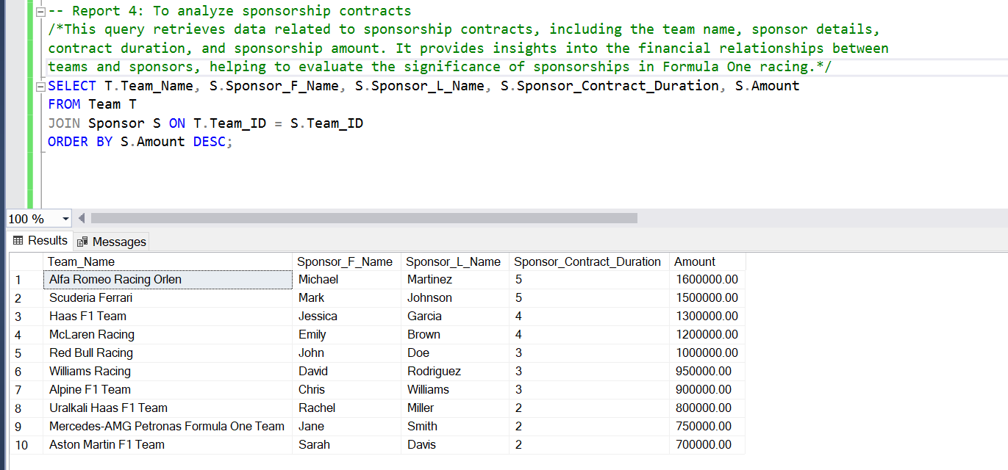
SQL QUERY AND OUTPUT

Slide 20
CHALLENGES
Crafting complex queries with multiple tables or conditions is tricky.
Effective error handling is crucial for dealing with unexpected issues.
Thorough documentation is vital for code understanding and maintenance.
Resource optimization, like reducing redundant data and using indexes efficiently, is key for system efficiency.
SOLUTIONS
Visualize complex queries for clarity.
Use error handling for unexpected issues.
Document code thoroughly for maintenance.
Optimize queries to improve performance.

Slide 21
THANK YOU

